Slide 1
Structure and Union
Algorithm and programming
Shania Priccilia, S.Kom., M.Kom.

Slide 2
Learning Objectives
At the end of this session, student will be able to:
Apply the concept of structure data type for various type of data (homogenous or heterogeneous) (LO2 & LO3)

Slide 3
Subtopics
Structure
Local Structure
Nested Structure
Structure Initialization
Array of Structure
Pointer of Structure
Typedef
Union Definition
Union Declaration
Enumeration
Exercise

Slide 4
structure
definition
A structure is a data type used to store a group of data elements with different data types.
The components of a structure are called members, fields, or elements.
It is a heterogeneous data type, meaning its elements can have different data types.
In some other programming languages, a structure is also known as a record.

Slide 5
structure
declaration
Syntax
struct name_structure {
dataType1 name_field1;
dataType2 name_field2;
…
};
Variable can be defined at declaration time
struct name_structure {
dataType1 name_field1;
dataType2 name_field2;
…
} name_variable_structure ;
    Structure variable declaration
Struct name_structure name_variable_structure;

Slide 6
structure
declaration
Example 1:
struct account{
int accountNo;
char accountType;
char name[31];
long credit;
};
struct account customer1, customer2;
OR
struct rekening {
int accountNo;
char accountType;
char name[31];
long credit;
} customer1, customer2;

Slide 7
structure
declaration
Example 2:
struct automobile {
int year;
char model[8];
int engine_power;
float weight;
};
struct Mahasiswa{
int Nim;
char name[20];
float IPK;
char gender;
};

Slide 8
structure
declaration
Example 3:
# include <stdio.h>
# include <string.h>
struct tmhs { // structure data type
char nim[11];
char name[26];
float gpa;
};
void function1 ( ) {
struct tmhs akad_mhs; // variable of structure
...
}
int main (){
...
struct tmhs ali, tono; // variable of structure
...
}

Slide 9
structure
declaration
Example 4:
# include <stdio.h>
# include <string.h>
struct tmhs { // structure data type
char nim[11];
char name[26];
float gpa;
} akad_mhs, ali, tono; // global variable of structure
void function1 ( ) {
...
}
int main (){
...
}

Slide 10
structure
declaration
Example 5:
# include <stdio.h>
struct {
char nim[11];
char name[26];
float gpa;
} akad_mhs, tono, ali; // global variable of structure
int main (){
...
}
Structure can be used without naming, structure variable can be directly declared along with structure declaration

Slide 11
structure
initialization
Syntax:
struct struct_name variable = {value_1, …, value_m};
Example:
struct account customer1 = {1984, 'a', "frenzy", 200000, 19};
#include <stdio.h>
struct employee {
int id;
char name[32];
};
int main() {
struct employee info = {1,"B. Smith"};
printf("name Employee: %s\n", info.name);
printf("ID Employee: %04d\n\n", info.id);
  return 0;
}

Slide 12
structure
initialization
Structure variable can be assigned with other structure variable with similar structure name
#include <stdio.h>
struct employee {
int id;
char name[32];
};
int main(){
struct employee info = {1,"B. Smith"};
struct employee amir = info;
printf("name Employee: %s\n", amir.name);
printf("ID Employee: %04d\n\n", amir.id);
return 0;
}

Slide 13
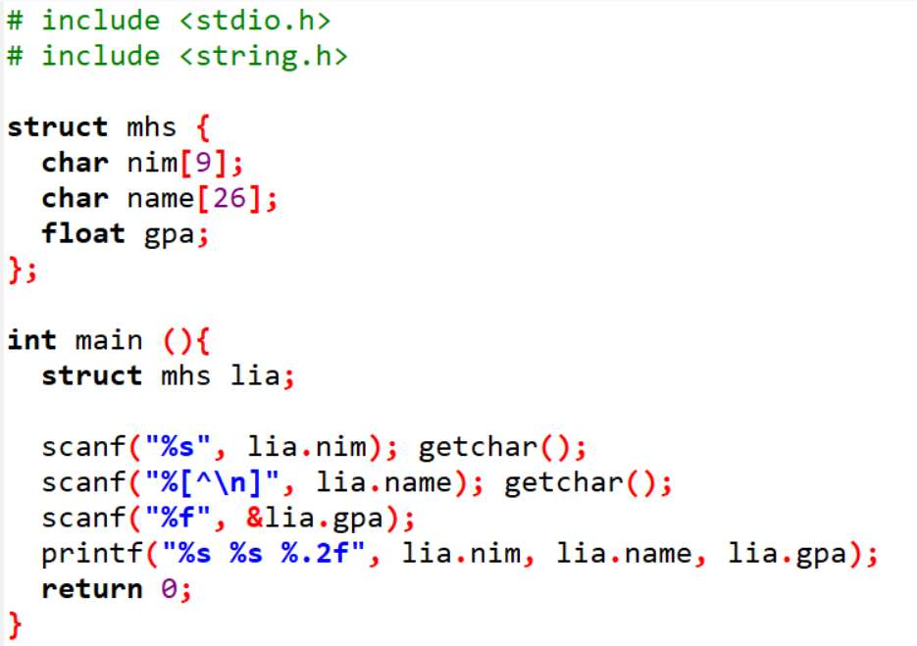
structure
accessing
Element (field) of a structure can be accessed using dot operator from structure variable

Slide 14
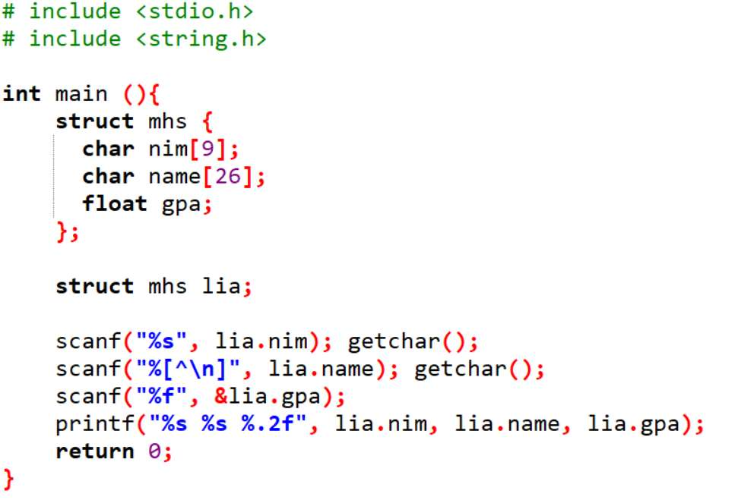
Local structure
definition
A structure can also be declared inside another function.

Slide 15
Nested structure
definition
struct Address {
  char street[40];
  int number;
  char city[20];
  char province[20];
};
struct Dob{
  int date, month, year;
};
struct Mhs{
  int nim;
  char name[20];
  struct Address addr;
  struct Dob dateofbirth;
};
Nested Structure is a structure with one of its element is another structure.
Structure as a member should be declared in advance.
Example:
  struct mhs consists of nim, name, address, dob
  address is a structure consists of name street, number, city, and province.
  dob is a structure consists of date, month and year.

Slide 16
Pointer of Structure
definition
Like any variable, a structure can also be pointed to by a pointer.
To access member of structure using pointer, we can use operator ->
struct Student {
char name[50];
float gpa;
};
int main() {
struct Student s1 = {"Alice", 3.75};
struct Student *ptr = &s1;
// Access using pointer
printf("Name: %s\n", ptr->name); //equals to (*ptr).name
printf("GPA: %.2f\n", ptr->gpa); //equals to (*ptr).gpa
return 0;
}

Slide 17
Array of Structure
definition
Structure data type can only contain one record. Real world problem needs group of records.
In practice, structure usually used in conjunction with array.
struct Dob{
int date, month, year;
};
struct Account {
int accountNo;
char accountType;
char name[31];
long credit;
struct Dob lastTrans;
};
struct Account customer[100]; //Array of structure

Slide 18
Array of Structure
initialization
struct dob{
char name[31];
int date, month, year;
};
struct dob birthday[ ] = {
{"Tata", 9, 7, 1984},
{"Titi", 7, 9, 1986},
{"Tutu", 9, 9, 1990}
};

Slide 19
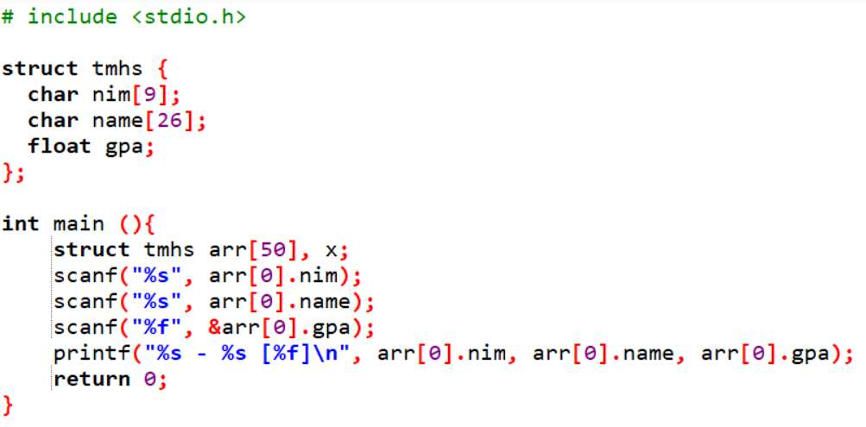
Array of Structure
example

Slide 20
Typedef
definition
typedef is a keyword used to create an alias (alternative name) for an existing data type.
It helps simplify complex or lengthy type declarations, making code easier to read and maintain.
It is especially useful for structures, pointer types, or other custom data type.
Example:
typedef struct BinusStudent{
  char name[20];
  int nim;
  float gpa;
}Mhs;
Mhs ali, tono;
Mhs is an alias name of struct BinusStudent, and its function as a new data type.

Slide 21
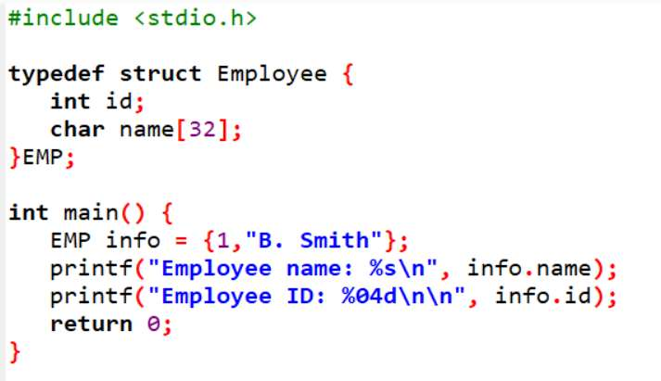
Typedef
example
Output:
Employee name: B. Smith
Employee ID: 0001

Slide 22
union
definition
Union is used for memory join. By using union, a memory location can be assigned for two or more variable with different data types.
Memory capacity used by union is the largest capacity used by any element of the union
Syntax:
  union name_union{
  typedata1 name_var1 ;
  typedata2 name_var2;
  ……
  } name_var_union;
  union name_union name_var_union;

Slide 23
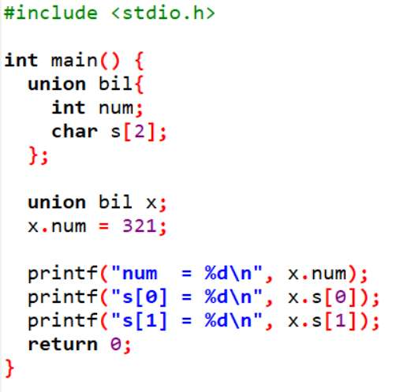
union
example
Output:
num = 321
s[0] = 65
s[1] = 1
321= 101000001

Slide 24
enumeration
definition
Enumeration is a data type with predefined number of data. This limited number of data is named for program readability.
Syntax:
  enum name_type {
    const1, const2,… const_n
  }name_var
  enum name_type name_var;

Slide 25
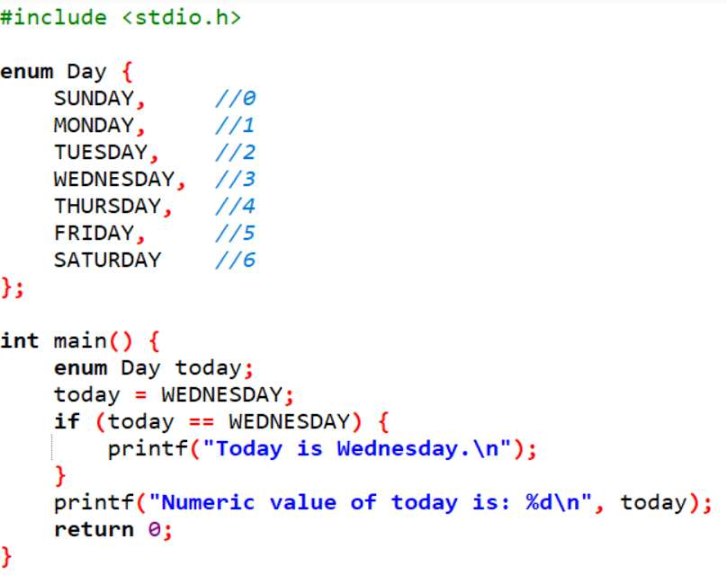
enumeration
example
Output:
Today is Wednesday.
Numeric value of today is: 3

Slide 26
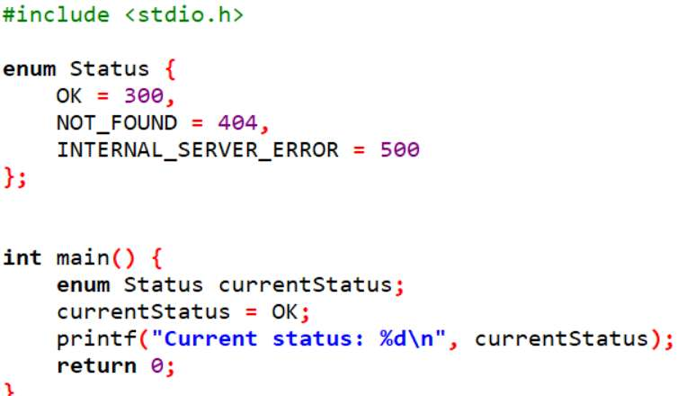
enumeration
example
By default, enum values start at 0 and increment by 1.
We can assign custom values.
Output:
Current Status: 300

Slide 27
exercise
Question 1
Create a structure with the following definition:
Struct Student consists of student number, name, address, place and date of birth.
Address is a struct itself consists of street name, number, city, province.
Date of birth is a struct with element: date, month and year.
Question 2
Based on previous exercise create a program to input 5 students data (use array of structure)

Slide 28
exercise
Question 3
Based on the following structure, create an application using array of structure to input 5 car types, and display them on the screen!
struct automobile {
int year;
char model[8];
int engine_power;
float weight;
};

Slide 29
exercise
Question 4
Using the following structure, create a program to input 5 students data and display students with gpa >= 3.0 and gpa < 3.0. Example :
struct ipk {
  char nim[11];
  char name[30];
  float gpa;
};
Output:
Students gpa >=3.0 :
Andi
Budi
Candra
Students gpa < 3.0 :
Emin
Dadu

Slide 30
exercise
Question 5
Create a program (not using array) to receive input for studentScore struct and then display nim, name, subjectCode, sks, and grade.
struct studentScore {
  char nim[11];
  char name [30];
  char subjectCode [5];
  int sks;
  char grade;
};

Slide 31

exercise
Question 6
Using previous exercise, consider the following grading and sks table. Create a program using array of struct to input 5 subject score of 1st semester then display the student’s GPA!

Slide 32
SUMMARY
Structure is a data type to store group of data with various of data type
Structure in other programming language also called record
Nested Structure is a structure with one of its element is another structure.
Union is used for memory join. By using union, a memory location can be assigned for two or more variable with different data types

Slide 33
REFRENCES
Paul Deitel & Harvey Deitel. (2021). C how to program. 09. Pearson Education. New York. ISBN: 9780137398393.
Collecting Data Items of Different Types: http://aelinik.free.fr/c/ch19.htm
Structs, Enums, and Unions: http://www.lysator.liu.se/c/c-faq/c-9.html

